Slide 1


2019
Department
Of Computer
Science
&
Electrical And
Electronics
Engineering
MATH-IV
KAS -402
2020-2021
Dr.Rupa Sharma
Associate Professor
vsrsrsys@gmail.com
Notes:
Thisv is Cover page

Slide 2
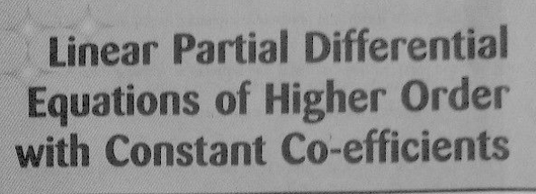
Topic- 6

Slide 3
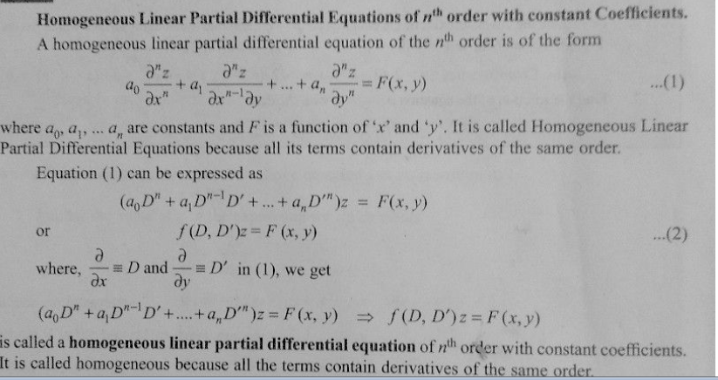

Slide 4
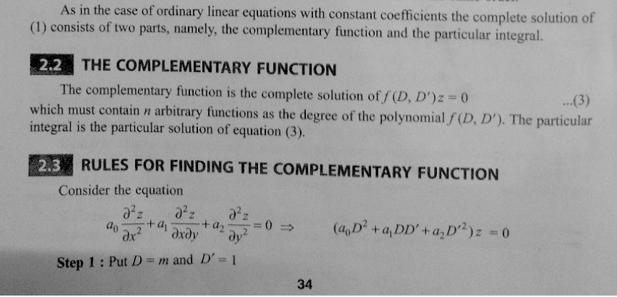

Slide 5
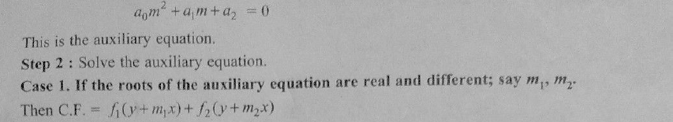
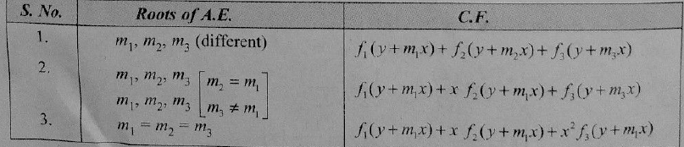

Slide 6
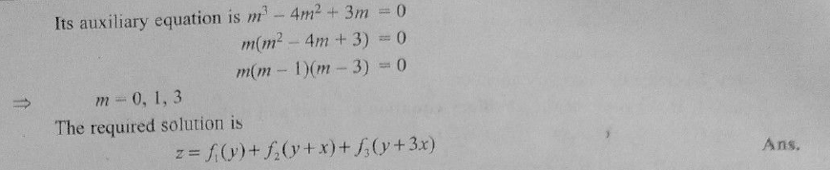

Slide 7
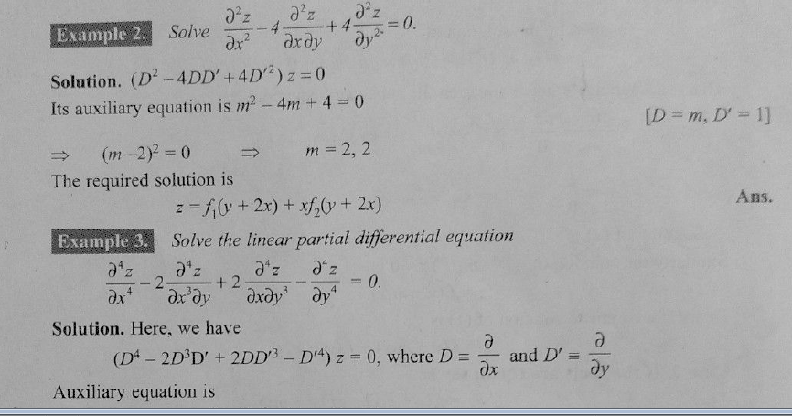

Slide 8
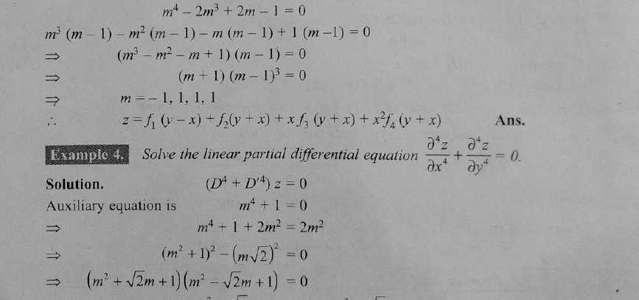

Slide 9
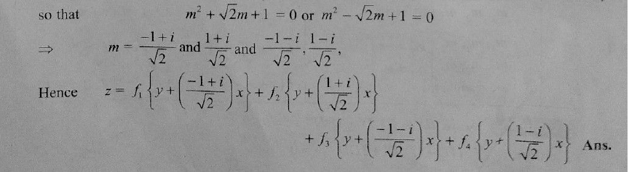

Slide 10
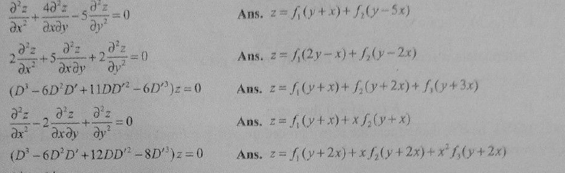
Home Work

Slide 11
THANK YOU

